Slide 1
MULTIPLE BREAK REBAR
Advisor : Prof. K.C.Chang
Presenters : You-Ran Nai

Slide 2
Incremental Dynamic Analysis with Multi-Modes for Seismic Performance Evaluation of RC Bridges
Prakit Chomchuen, Virote Boonyapinyo
Engineering Structures
February 2017

Slide 3
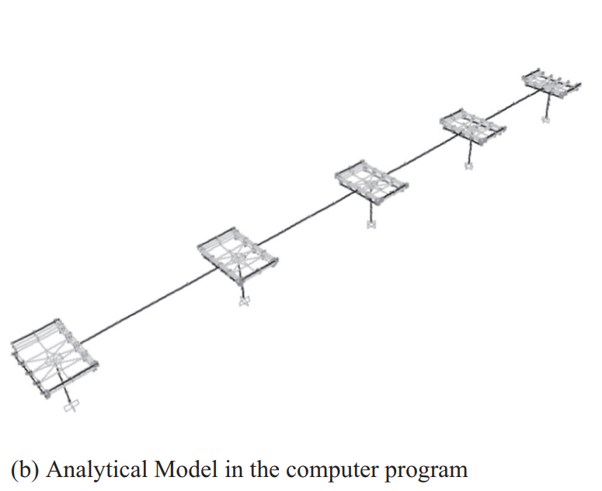
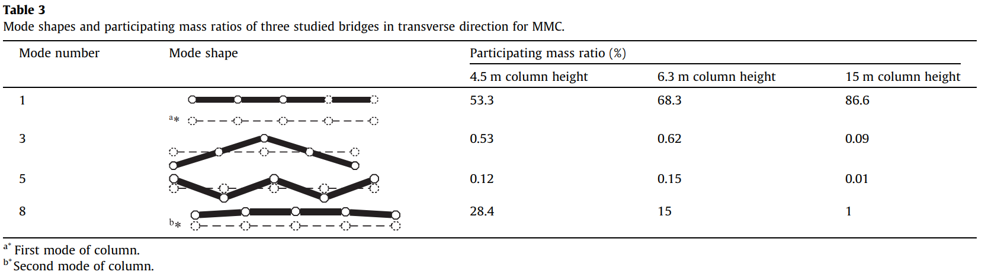
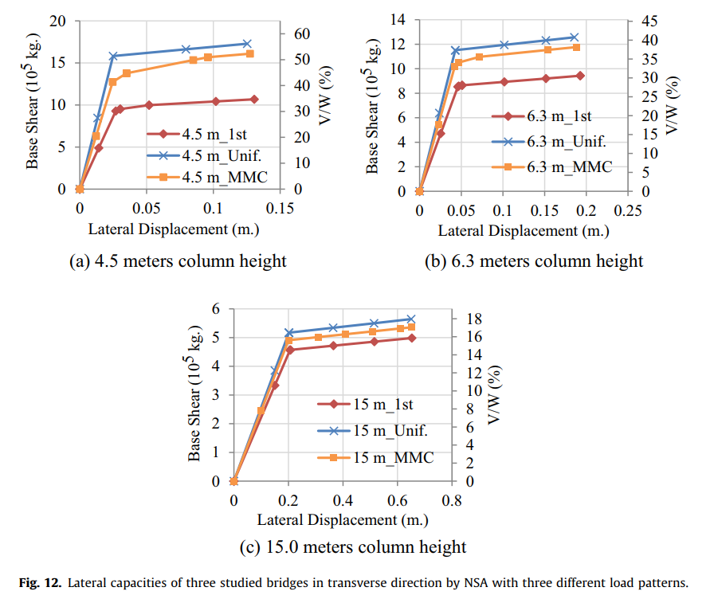
WHY ONE YIELDING?
5 COLUMNS
SAME HEIGHT
5 COLUMNS
SIMULTANEOUSLY YIELDING
ONE YIELDING

Slide 4
Incremental dynamic analysis
Dimitrios Vamvatsikos and C. Allin Cornell
EARTHQUAKE ENGINEERING AND STRUCTURAL DYNAMICS
2002
Notes:
Department of Civil and Environmental Engineering; Stanford University; CA 94305-4020; U.S.A.

Slide 5




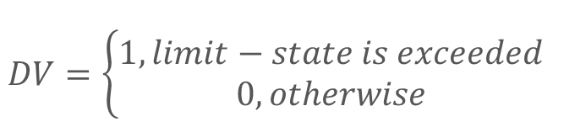

PBEE FRAMEWORK
$$DV=\left\{\begin{aligned}1, limit−state is exceeded \\ 0, otherwise\end{aligned}\right.$$
$$λ\left(IM\right): hazard curve$$
$$G\left(DM | IM\right):(conditional) complementary cumulative distribution$$

Slide 6
BEFORE
AFTER

Slide 7
91.8%
95.5%
98.2%
62.4%
75.9%

Slide 8
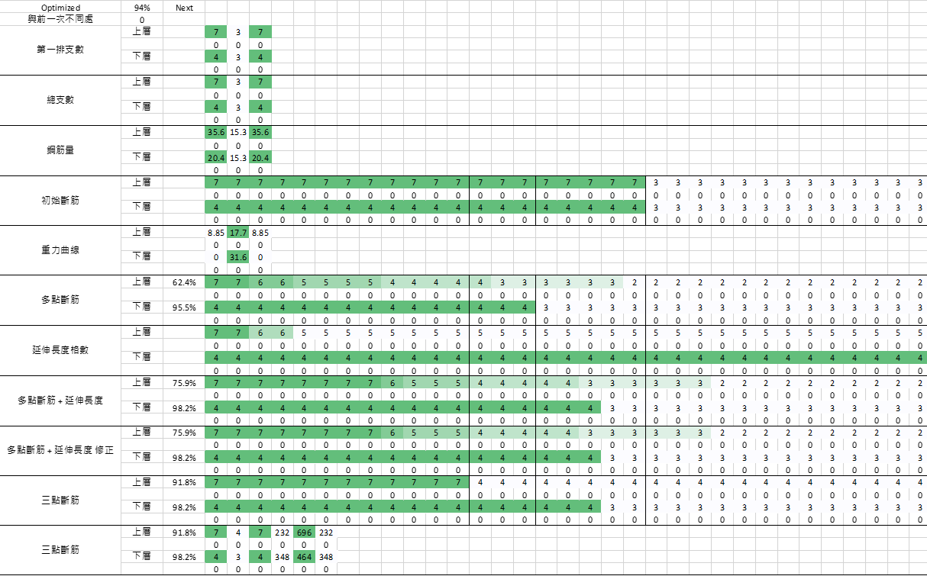

Slide 9
LINEAR - FROM EXISTING REBAR
1
2
3
4
5
MOMENT DIAGRAM
TENSION DEVELOPMENT LENGTH
GRAVITY DEMAND
LOAD PATTERN
REDUCE TO THREE / FOUR POINTS
Notes:
- 推估的演算法是用彎矩圖，上層筋以地震力，下層筋以重力與地震力進行多點斷筋。
- 並加上精算法的延伸長度。
- 手動輸入 Gravity 需求。(忽略帶寬、不平均)
- 手動輸入 Gravity 負彎矩偏差比例。Load Pattern Fix fix , fix pin , pin-fix , pin-pin
- 由無限斷筋縮減到有限點斷筋(3 點或 4 點) - 排列組合、分群演算法。

Slide 10
Use case
1
2
3
4
5
Very Easy Step 1
Very Easy Step 2
Very Easy Step 3
Very Easy Step 4
Very Easy Step 5

Slide 11
REDUCE TO THREE POINTS
FINITE PERMUTATION
0.15~0.4
TO AVOID EXTREME SITUATION
0.15~0.4
0.6~0.85

Slide 12
PRECONDITION
LATERAL FORCE(EARTHQUAKE OR WIND)
DEAD LOAD
LIVE LOAD
GIRDER
EARTHQUAKE VERTICAL FORCE
LATERAL EARTH PRESSURE, GROUND WATER PRESSURE, OR PRESSURE OF BULK MATERIALS

Slide 13
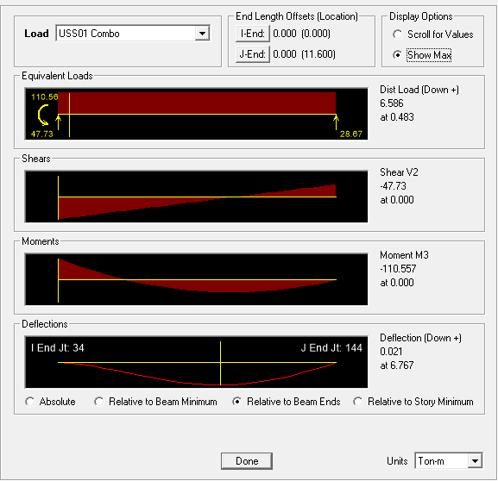
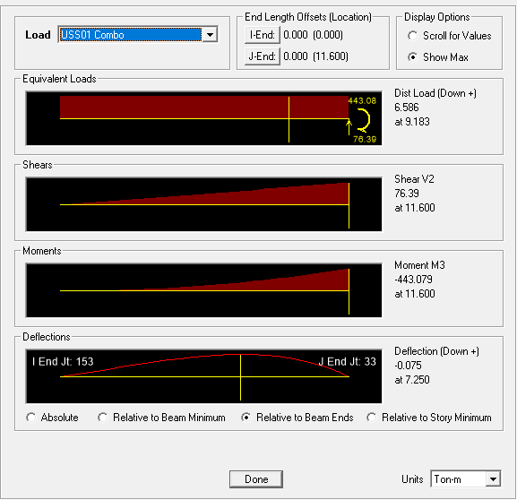
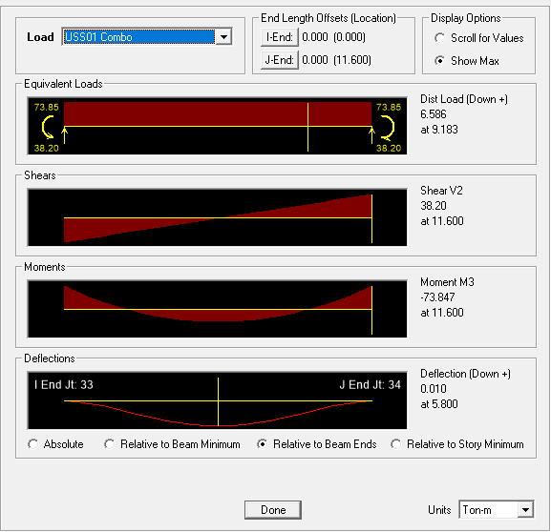
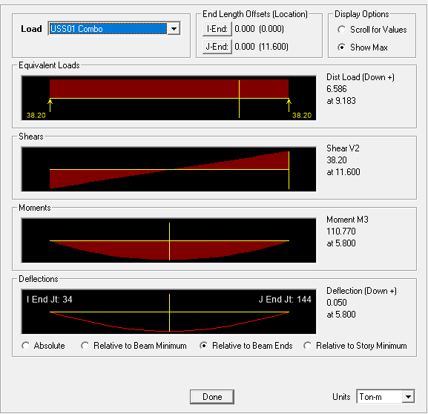
PRECONDITION
FIX-FIX
BOUNDARY CONDITION
FIX-PIN
FIX-FREE
PIN-PIN

Slide 14
ALGORITHM
INITIAL REBAR

Slide 15
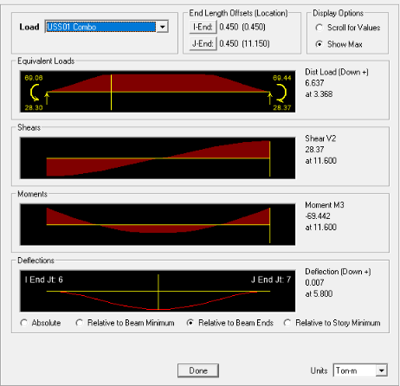
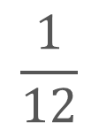
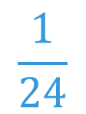
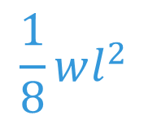
(SDL + SLAB) LL
BAND SPAN
$$\frac{1}{8}wl^{2}$$
➔
(1) U=1.4D
(2) U=1.2D + 1.6L
(3) U=1.2D + (1.0L or 0.5L)
(4) U=1.2D + 1.6W + (1.0L or 0.5L)
(5) U=1.2D + 1.0E + (1.0L or 0.5L)
(6) U=0.9D + 1.6W
(7) U=0.9D + 1.0E
50%
$$\frac{1}{12}$$
$$\frac{1}{24}$$
➔
0.9 * Mn = 0.9 * As * Fy * 0.9d >= Mu
94%

Slide 16
ALGORITHM
(1) U=1.4D
(2) U=1.2D + 1.6L
(3) U=1.2D + (1.0L or 0.5L)
(4) U=1.2D + 1.6W + (1.0L or 0.5L)
(5) U=1.2D + 1.0E + (1.0L or 0.5L)
(6) U=0.9D + 1.6W
(7) U=0.9D + 1.0E
LATERAL
FORCE
GRAVITY LOAD

Slide 17
ALGORITHM
(1) U=1.4D
(2) U=1.2D + 1.6L
(3) U=1.2D + (1.0L or 0.5L)
(4) U=1.2D + 1.6W + (1.0L or 0.5L)
(5) U=1.2D + 1.0E + (1.0L or 0.5L)
(6) U=0.9D + 1.6W
(7) U=0.9D + 1.0E
LATERAL
FORCE
GRAVITY LOAD

Slide 18
ALGORITHM
CHANGE TO
REBAR NUMBER
LINEAR ADD

Slide 19
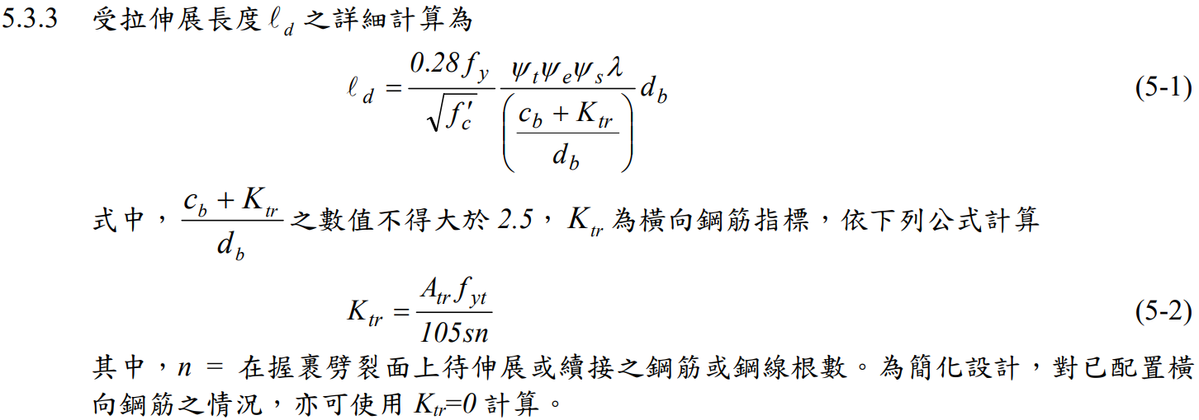
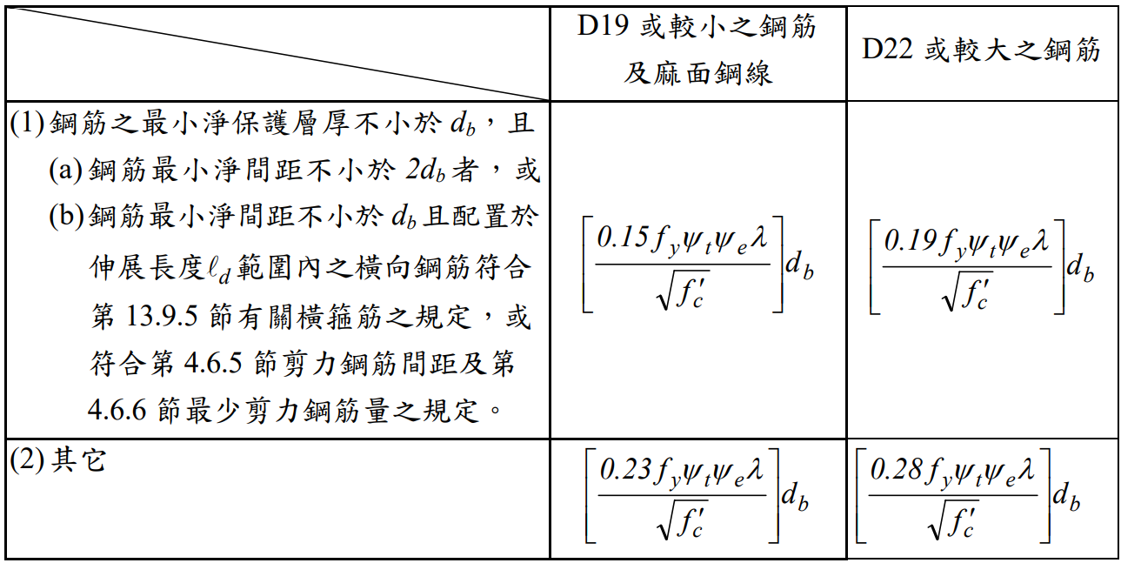
GENERAL DEVELOPMENT LENGTH EQUATION
DEVELOPMENT LENGTH
MIN
SIMPLIFIED PROVISIONS
Beam width, cover, Fy, Fyt, Fc’,
Rebar‘s Db, Stirrup’s Db,
Spacing, rebar number

Slide 20
ALGORITHM
REDUCE TO THREE POINTS
0.15~0.4
0.6~0.85

Slide 21
Punchline of your project in a few words
Here is the subline, explain your project in 2-3 lines so that we clearly understand the value proposal.

Slide 22
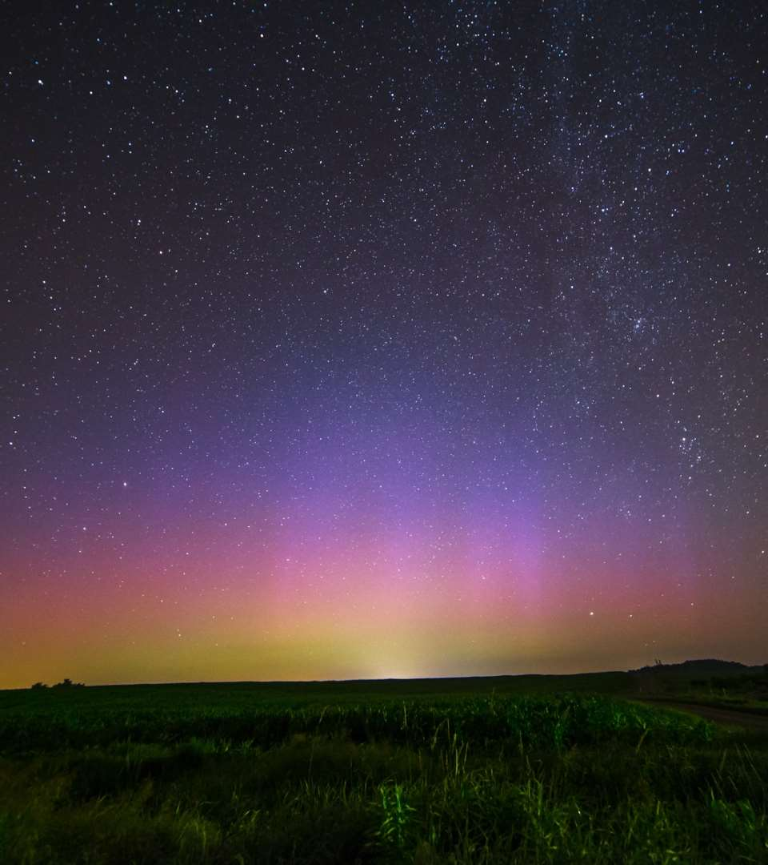
The problem you want to solve

Slide 23
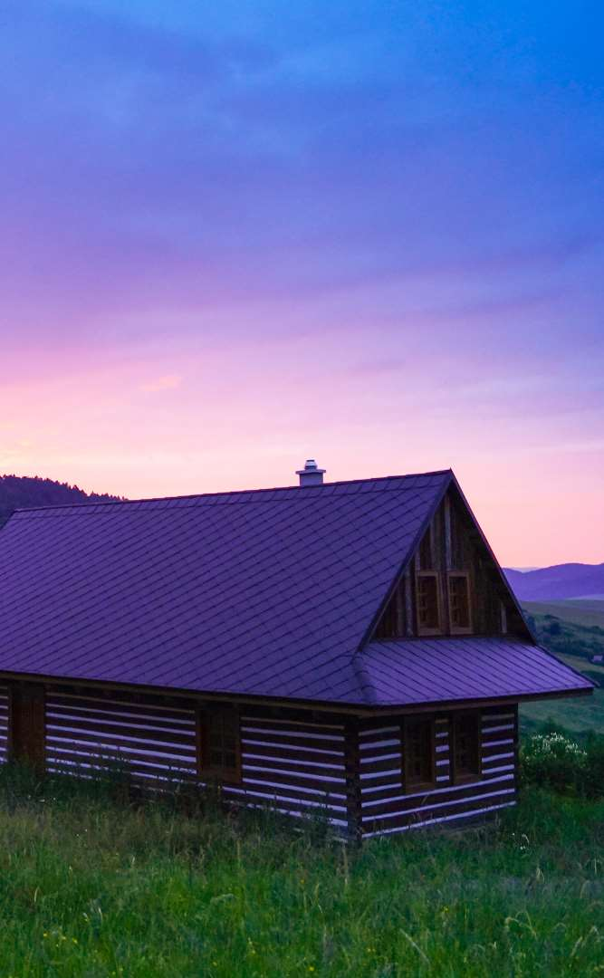
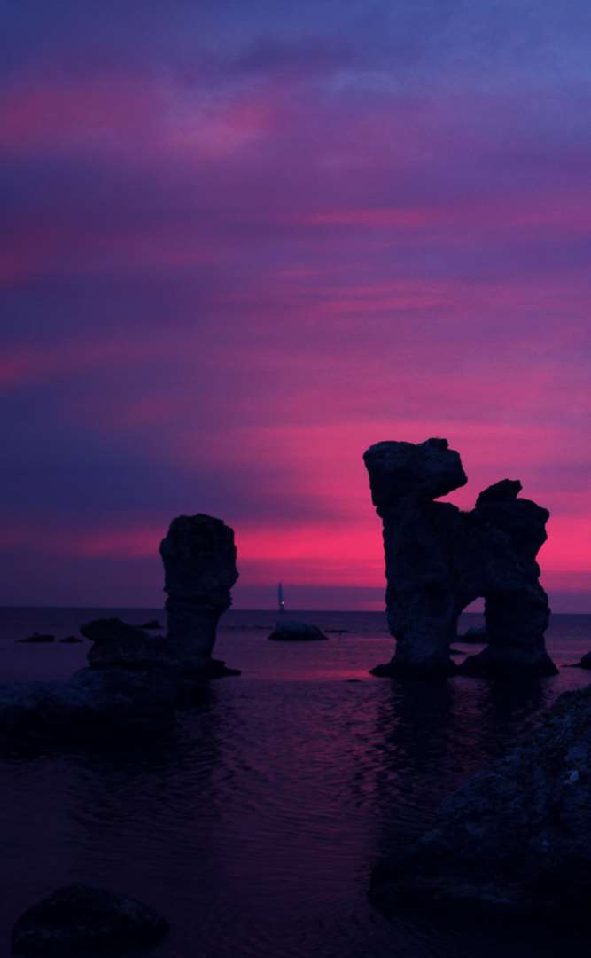

Today’s solutions

Slide 24
Why it doesn’t work
Difficult to implement
Expensive for small businesses
Zero customization

Slide 25

Your solution

Slide 27
Your solution

Slide 28
Your solution

Slide 29
Your solution

Slide 31
Your solution

Slide 32
Awesome features
Awesome map feature
Awesome like feature
Awesome battery feature

Slide 33
Use case
1
2
3
4
5
Very Easy Step 1
Very Easy Step 2
Very Easy Step 3
Very Easy Step 4
Very Easy Step 5

Slide 34
Value Proposal
Make things really change
Make the world a better place
Offer one perfect answer
This is how we are going to make this happen in a beautiful way.
This is how we are going to make this happen in a beautiful way.
This is how we are going to make this happen in a beautiful way.

Slide 35
Market Sizing
$36b
$12b
$2b
Total World Market
Total US Market
Total FR Market
Source : source.io
Source : source.io
Source : source.io

Slide 36
Market Size over Time
Market Sizing (in €billions)

Slide 37
Market on Map
$1b
$2b

Slide 38
Why Now ?
Mobile Internet Usage

Slide 39


Customer Profiles
Young adults
25-35 years old
Students
15-20 years old

Slide 40
Competitors

Slide 41
AXIS 2
Your company
competitor
competitor
AXIS 1
AXIS 1
competitor
competitor
competitor
competitor
AXIS 2

Slide 42
 | YOUR COMPANY | COMPETITOR 1 | COMPETITOR 2 | COMPETITOR 3
feature 1
feature 2
feature 3
feature 4
feature 5
feature 6

Slide 43
Metrics
800
97%
94%
Paying users
Margin
Recurring users
$150,000
85,000
54
Monthly Recurring
Revenue
Users growing 45% per month
API Integrations

Slide 44
Conversion Rate
0,27%

Slide 45
Split Budget

Slide 46
Split Budget
75%
69%
30%
29%
29%
Marketing
Research
Sales
Design
Hiring

Slide 47
Forecast

Slide 48
Financial Table
 | 2016 | 2017 | 2018 | 2019 | 2020
Sales | 0 | 50 | 400 | 1000 | 3000
Revenue | - | $100 000 | $800 000 | $2 000 000 | $6 000 000
Gross Margin (%) | - | 49% | 51% | 53% | 58%
Expenses | - | $128 000 | $450 000 | $800 000 | $1 200 000
Net Profit | - | $-28,000 | $350 000 | $1 200 000 | $4 800 000
Profit Margin (%) | - | -28% | 44% | 60% | 80%

Slide 49
Outstanding Founders
Dave Lopper CTO
Come Mertial CEO
Tran Zition
CPO
Google
Facebook
Stanford
Microsoft
SalesForce
HEC Paris
Uber
Awwwards
MIT Media Lab

Slide 50
Advisors and Directors
Jérémy Vestiaire
Financial Advisor
Goldman Sachs
Jey Bestelgram
Product Advisor
Amazon
Oudam Dadam
Machine Learning Enthousiast
SpaceX
Tomy Lamousse
PR Advisor
Mashable
Lam Ontarelle
UX Contributor
Slidor
Renaude Yorella
Board Member
Sequoia Capital
Laurence Marc
Board Member
Accel Partners
Vince Lacluze
UI Director
Snapchat

Slide 51
Roadmap
02/2016
04/2016
06/2016
Market Overview
Pre-Release
Launch
01/2016
03/2016
05/2016
Introduction
Partnerships
Beta

Slide 52
Say you want to make the world a better place

Slide 53
Icons

Slide 54
Icons

Slide 55
Social

Slide 56
Red
Pink
Purple
Deep Purple
Indigo
Blue
Light Blue
Cyan
Teal
Green
Light Green
Lime
Yellow
Amber
Orange
Deep Orange
50
50
50
50
50
50
50
50
50
50
50
50
50
50
50
50
100
100
100
100
100
100
100
100
100
100
100
100
100
100
100
100
200
200
200
200
200
200
200
200
200
200
200
200
200
200
200
200
300
300
300
300
300
300
300
300
300
300
300
300
300
300
300
300
400
400
400
400
400
400
400
400
400
400
400
400
400
400
400
400
500
500
500
500
500
500
500
500
500
500
500
500
500
500
500
500
600
600
600
600
600
600
600
600
600
600
600
600
600
600
600
600
700
700
700
700
700
700
700
700
700
700
700
700
700
700
700
700
800
800
800
800
800
800
800
800
800
800
800
800
800
800
800
800
900
900
900
900
900
900
900
900
900
900
900
900
900
900
900
900
A100
A100
A100
A100
A100
A100
A100
A100
A100
A100
A100
A100
A100
A100
A100
A100
A200
A200
A200
A200
A200
A200
A200
A200
A200
A200
A200
A200
A200
A200
A200
A200
A400
A400
A400
A400
A400
A400
A400
A400
A400
A400
A400
A400
A400
A400
A400
A400
A700
A700
A700
A700
A700
A700
A700
A700
A700
A700
A700
A700
A700
A700
A700
A700

Slide 57
Gradient 1

Slide 58
Gradient 2

Slide 59
Gradient 3

Slide 60
Gradient 4

Slide 61
Gradient 5

